Slide 1
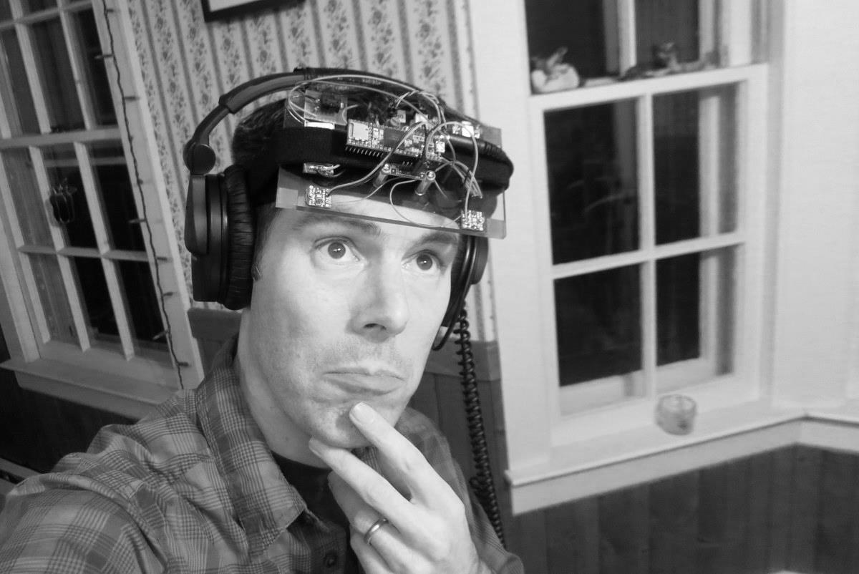
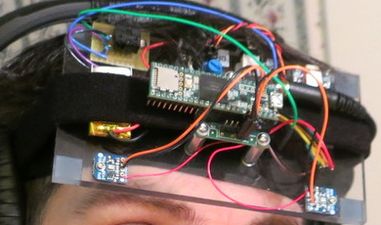
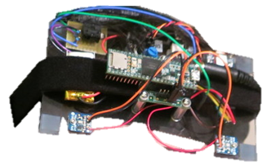

Slide 3
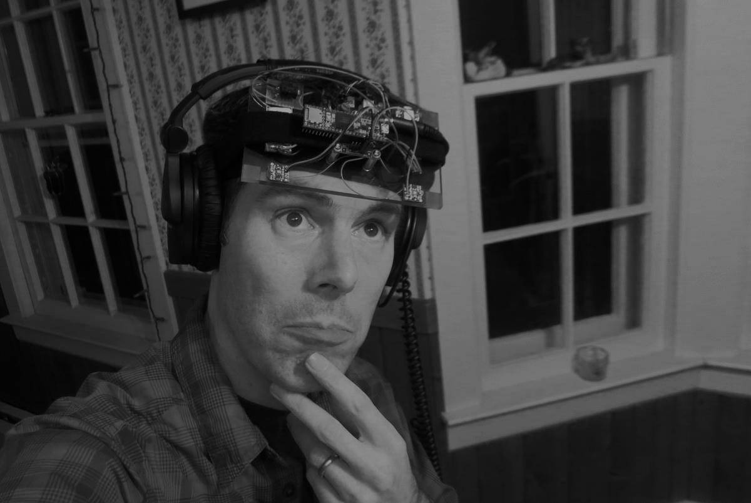
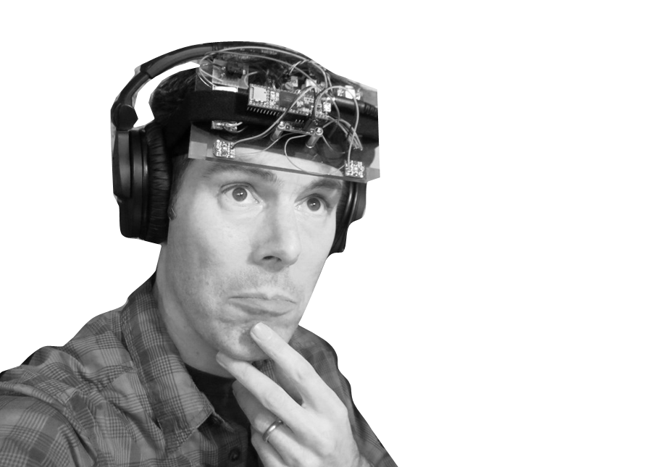
A Teensy Hearing Aid?

Slide 6
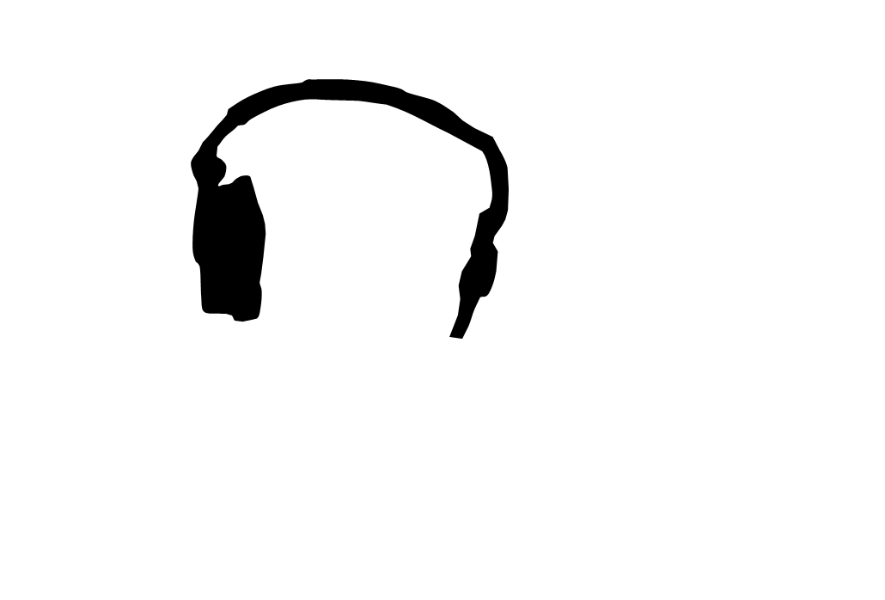
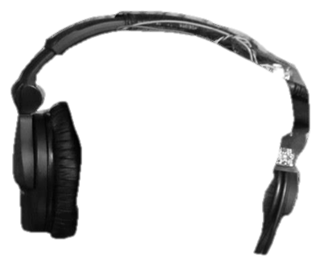

Slide 8


Slide 10


Slide 12


Slide 13
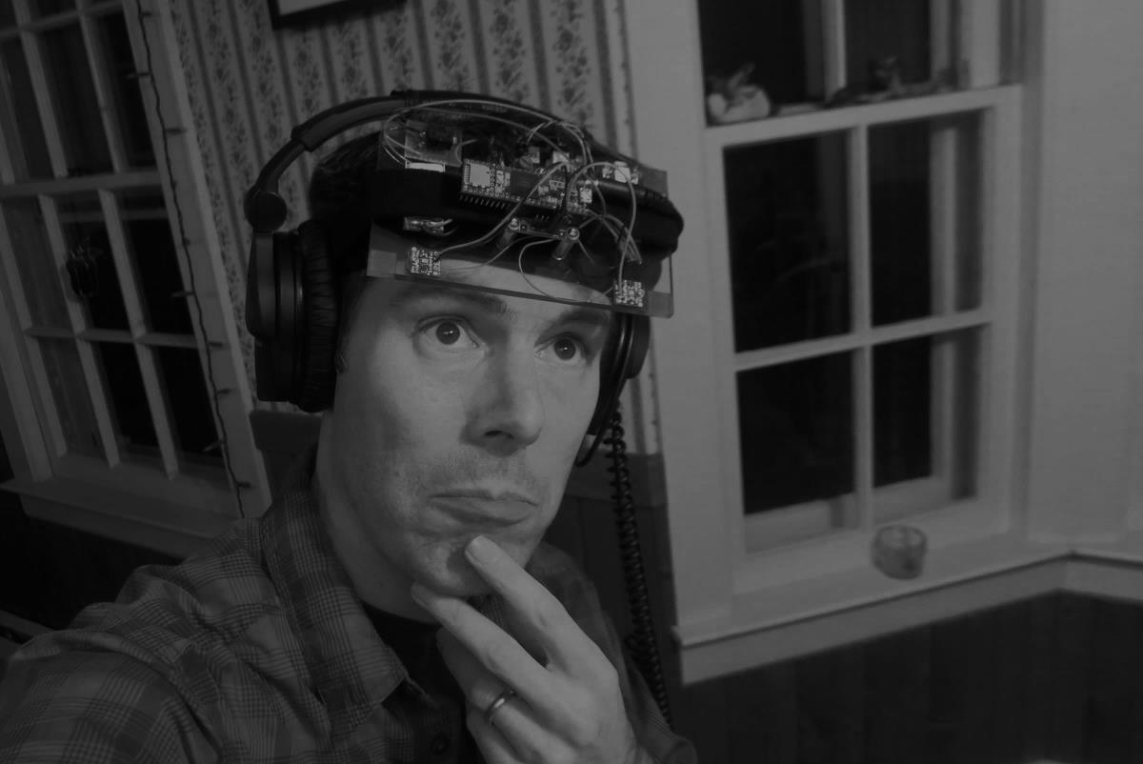
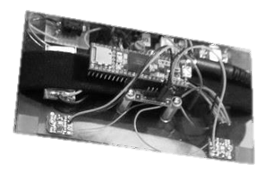
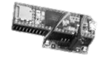

A Teensy Hearing Aid?

Slide 14
A Teensy Hearing Aid?

Slide 15
A Teensy Hearing Aid?

Slide 16
A Teensy Hearing Aid?

Slide 17
Elements of My Teensy Hearing Aid
Adafruit
SPW2430
Microphone(s)
Teensy
Audio Board
Analog to Digital Converter
Digital Audio Processor
Battery
Teensy
Audio Board
Digital to Analog Converter
Teensy
3.6
Adafruit
Li-Po and Charger
Speaker(s)
Headphones

